Slide 1
K- Nearest Neighbor (K-NN Algorithm)

Slide 2
K-Nearest Neighbor - Introduction
K-Nearest Neighbor (K-NN) is an instance-based (memory-based) algorithm.
supervised
Instance-based learning (sometimes called memory-based learning) is a family of learning algorithms that, instead of performing explicit generalization (in the training phase), compare new problem instances with instances seen in training, which have been stored in memory.
It is called instance-based because it constructs hypotheses directly from the training instances themselves.
The computation is postponed until a new instance is observed, these algorithms are sometimes referred to as "lazy."

Slide 3
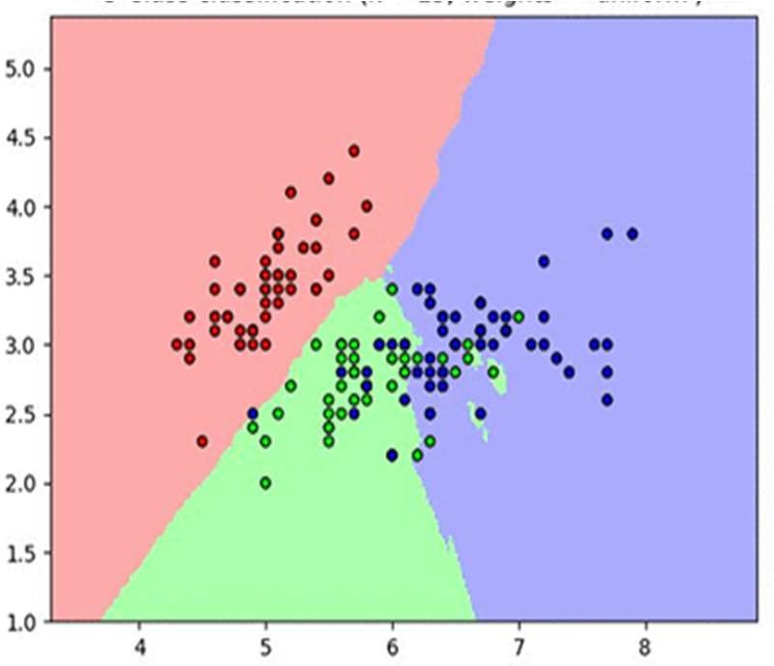
K-Nearest Neighbor – Introduction (Contd...)
K-NN is based on the fact that the similar objects lie in the close proximity to each other in the feature space.
The figure illustrates that the objects of the same class lie quite close to each other and hence a new test case can be compared with k closest training examples in data set.

Slide 4
K-Nearest Neighbor – Introduction (Contd...)
The k-nearest neighbors algorithm (k-NN), is used for classification and regression.
The output depends on whether k-NN is used for classification or regression:
In k-NN classification, the output is a class membership. An object is classified by a plurality vote of its neighbors, with the object being assigned to the class most common among its k nearest neighbors (k is a positive integer, typically small). If k = 1, then the object is simply assigned to the class of that single nearest neighbor.
In k-NN regression, the output is the property value for the object. This value is the average of the values of k nearest neighbors.

Slide 5
Working of K- Nearest Neighbor Algorithm
K-Nearest Neighbor algorithm works in the following steps:
Determine parameter K = number of nearest neighbors.
Calculate the distance between the query-instance and all the training samples.
Sort the distance and determine nearest neighbors based on the K-th minimum distance.
Gather the category Y of the nearestneighbors.
Use simple majority of the category of nearest neighbors as the label of the query instance in case of classification and average of the values of k nearest neighbors in case of regression.
(For classification, K must be set as odd number like 1,3,5 etc – so as to avoid tie during simple majority)

Slide 6
How to set value of K ?
In KNN, finding the value of k is very crucial. A small value of k means that noise will have a higher influence on the result and a large value make it computationally expensive.
If we choose our K = 1 , then our algorithm behaves as over fitting and it gives a non - smooth decision surface.
As K increases, our decision surface gets smoother and, if we choose K as very large, then our algorithm behaves as underfitting and it gives a smooth decision surface and everything becomes one class which is the majority class in our dataset.
So, we should choose K wisely such that it should neither be overfitting nor be underfitting .

Slide 7
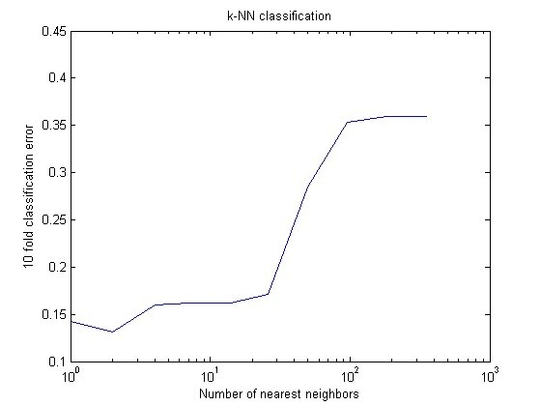
How to set value of K ?
Following approaches are used for setting value of K:
An odd number in case of classification.
Another simple approach to select k is set k
= sqrt(n/2). where n = number of data points in training data.
The best approach is to plot the mean square error (or error rate) in labeling/prediction for each value of K. Chose the first value for which error rate is minimum.
This technique can be combined with k-fold cross validation (as shown in the figure)
We can tune the number of k in kNN and plot with respect to the cross-validation error

Slide 8
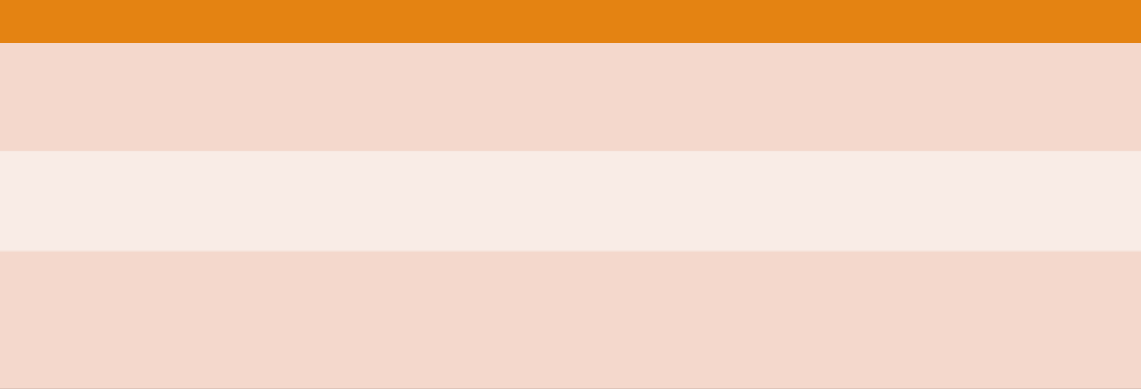
Distance Metrics for Continuous Variables
Following association metrics are used for continuous variables:
X_{ik} is the i^{th} instance of variable k, and p are the total number of features
Association Metric Formula
1. Minkowski Distance
p
𝑑 𝑋_{i}, 𝑋_{j} = Σ |𝑋_{ik} − 𝑋_{jk}|^{m}
k=1
p
𝑑 𝑋_{i}, 𝑋_{j} = Σ |𝑋_{ik} − 𝑋_{jk}|
k=1
1/m
2. Manhattan/ City-Block Distance
3. Euclidean Distance
p
𝑑 𝑋_{i}, 𝑋_{j} = Σ |𝑋_{ik} − 𝑋_{jk}|²
k=1

Slide 9





Distance Metrics for Continuous Variables
Association Metric Formula
4. Canberra Distance
p
ik
jk
i j
ik jk
k=1
p
5. Czekanowski Coefficient
ik jk
k=1 p
i j
k=1
ik jk

Slide 10
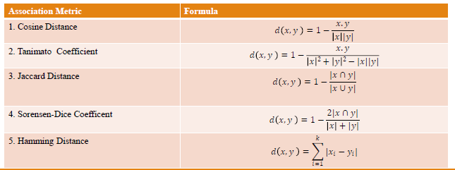
Distance Metrics for Categorical Features
If x and y are the feature vectors for two categorical vectors, than following metrics are used for K-NN Classifier:

Slide 11


Distance Metrics -Example
Consider the following Bag-of-Words Representation of three documents:
 | i | think | therefore | am | can | you | don’t | know | who
I think therefore I am | 2 | 1 | 1 | 1 | 0 | 0 | 0 | 0 | 0
Can you think | 0 | 1 | 0 | 0 | 1 | 1 | 0 | 0 | 0
I don’t think therefore I don’t know who I am | 3 | 1 | 1 | 1 | 0 | 0 | 2 | 1 | 1
Cosine Distance:
Tanimato Distance:

Slide 12


Distance Metrics –Example (Contd…)
Consider the following Bag-of-Words Representation of three documents:
 | i | think | therefore | am | can | you | don’t | know | who
I think therefore I am | 2 | 1 | 1 | 1 | 0 | 0 | 0 | 0 | 0
Can you think | 0 | 1 | 0 | 0 | 1 | 1 | 0 | 0 | 0
I don’t think therefore I don’t know who I am | 3 | 1 | 1 | 1 | 0 | 0 | 2 | 1 | 1
Jaccard Distance:
Dice –Coefficient:

Slide 13
K-NN Classifier- Numerical Example 1
We have data from the questionnaires survey (to ask people opinion) and objective testing with two attributes (acid durability and strength) to classify whether a special paper tissue is good or not. Here is four training samples:
X1 =Acid Durability (seconds) | X2 = Strength (kg/squaremeter) | Y= Classification
7 | 7 | Bad
7 | 4 | Bad
3 | 4 | Good
1 | 4 | Good
Now the factory produces a new paper tissue that pass laboratory test with X1 = 3 and X2 = 7. Without another expensive survey, can we guess what the classification of this new tissue is?

Slide 14
Example 1- Solution
1. Determine parameter neighbors
Suppose use K = 3
K = number of nearest
2. Calculate the distance between the query-instance and all the training samples
Coordinate of query instance is (3, 7), instead of calculating the distance we compute square distance which is faster to calculate (without square root)

Slide 15
Example 1- Solution (Contd…)
X1 = Acid Durability (seconds) | X2 = Strength (kg/square meter) | Square Distance to query instance (3, 7)
7 | 7 | (7-3)²+(7-7)²=16
7 | 4 | (7-3)²+(4-7)²=25
3 | 4 | (3-3)²+(4-7)²=9
1 | 4 | (1-3)²+(4-7)²=13

Slide 16
Example 1- Solution (Contd…)
3. Sort the distance and determine nearest neighbors based on the K-th minimum distance
X1 | X2 | Square Distance to query instance (3, 7) | Rank minimum distance | Is it included in 3- Nearest neighbors?
7 | 7 | (7-3)²+(7-7)²=16 | 3 | Yes
7 | 4 | (7-3)²+(4-7)²=25 | 4 | No
3 | 4 | (3-3)²+(4-7)²=9 | 1 | Yes
1 | 4 | (1-3)²+(4-7)²=13 | 2 | Yes

Slide 17
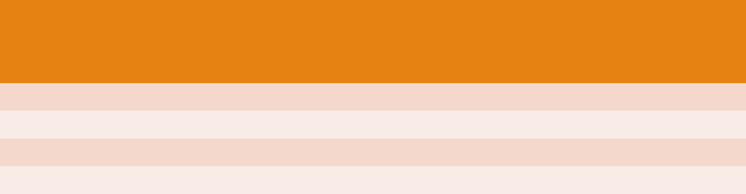
Example 1- Solution (Contd…)
4. Gather the category Y of the nearestneighbors. Notice in the second row last column that the category of nearest neighbor (Y) is not included because the rank of this data ismore than 3 (=K).
X1 | X2 | Square Distance to query instance (3, 7) | Rank minimum distance | Is it included in 3-Nearest neighbors? | Y= Category of nearest Neighbor
7 |  | 7 (7-3)²+(7-7)²=16 | 3 | Yes | Bad
7 |  | 4 (7-3)²+(4-7)²=25 | 4 | No | -
3 |  | 4 (3-3)²+(4-7)²=9 | 1 | Yes | Good
1 |  | 4 (1-3)²+(4-7)²=13 | 2 | Yes | Good
Use simple majority of the category of nearest neighbors as the prediction value of the query instance. We have 2 good and 1 bad, then we conclude that a new paper tissue that pass laboratory test with
X1 = 3 and X2 = 7 is included in good category.

Slide 18
Advantages of K-NN Algorithm
Prediction quality:
A kNN classifier is able to recover unstructured partitions of the space, as opposed to, say, a linear classifier that requires a linear separation between the classes.
It can also adapt to different densities in the space, making it more robust than methods such as support vector machine (SVM) classification with radial basis function (RBF) kernel.
Short cycles:
Another advantage of kNN is that there is little to no training involved.
This means that iterating over different possible metrics / modifications of the input dataset is potentially faster when compared to a classifier that requires a heavy training procedure.
Multi-Class Classification:
kNN can seamlessly handle a very large number of classes.
For comparison, a linear model or a deep neural network with a cross-entropy loss must explicitly compute a score for each possible class, and choose the best one.

Slide 19
Advantages of K-NN Algorithm
Interpretability:
The prediction of a kNN model is based on similarity to existing objects.
As a result, the question “why was my example given class X?” is answered by “because similar items are labeled with X.”

Slide 20
Limitations of K-NN Algorithm
Costly inference:
The major disadvantage of kNN is its costly inference.
To infer the label of an input query, we must find the data points closest to it.
A naive solution would keep all data points in memory, and, given a query, compute the distance between it and all data points.
For concrete quantities, if the training set contained n data points of d dimensions, this process requires O(nd) arithmetic operations per query and O(nd) memory.

Slide 21
Reducing Inference Cost
Subsampling:
A very simple, yet often very effective way of reducing the inference cost is to subsample the data.
For example, we might have an available dataset of, say, 10M data points, but we can do a good enough job with 100K data points.
Dimension reduction:
For some distances, such as L2 and cosine distance, it’s possible to reduce the dimension of the data points while maintaining the distance between a query point and any data point that is approximately the same.
The quality of the approximation depends only on the dimension of the output.
Small dimension means a crude approximation, yet it is often the case that we can obtain a good enough approximation for the distances while reducing the dimension.
The main disadvantage of this method is that the output is dense, so for highly sparse data or data that had a low dimension to begin with, this might not be the best technique.

Slide 22
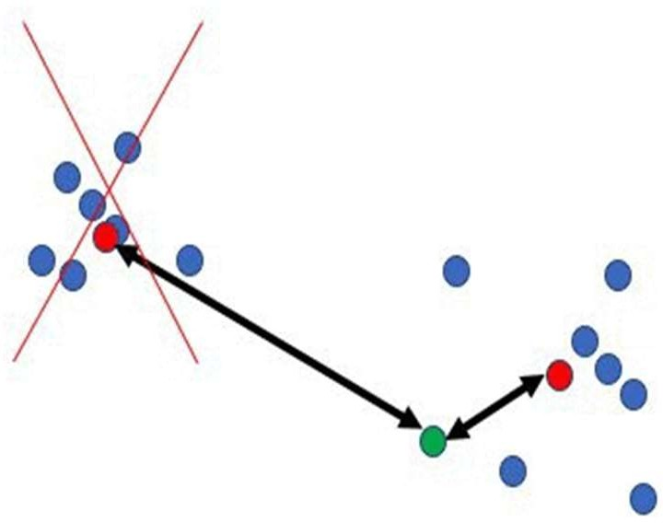
Reducing Inference Cost (Contd…)
Avoiding Regions Quickly:
A common approach for disqualifying data points quickly is through clustering.
If the center of a cluster is far away from the query we can disqualify the entire cluster without looking into all of its data points.
For this technique, the data must be pre-processed to obtain m << n centers, typically with k-means clustering.
Then, when a query arrives we compute its distance to all of the centers, and disregard all points that belong to clusters with centers far away from the query.

